Slide 1

Unit 1
How can we become good
learners?
Section B 3a- Self Check

Slide 2
By的用法
一、by+地点名词。
表方位，意为：“在…旁边”。
by the lake/river/tree/window/door等。
有时可表:“从…旁经过”,多与动词go /
walk / pass等连用

Slide 3
二、by+时间名词。
意为：“到…时（已发生某事），此时谓语多用完成时；最晚、不迟于…，在…之前”。
By the end of last year, another new
gymnasium had been completed.

Slide 4
三、by+名词。
1）可用来表方法、方式、手段
Cleaning women in big cities usually get paid
by the hour.
城市里的女清洁工通常按小时获得报酬。
2） by+交通工具、交通方式名词
by train /taxi/bus/truck/bike/boat/plane; by land/road/sea/water/air
PPT模板：www.1ppt.com/moban/ PPT素材：www.1ppt.com/sucai/
PPT背景：www.1ppt.com/beijing/ PPT图表：www.1ppt.com/tubiao/
PPT下载：www.1ppt.com/xiazai/ PPT教程： www.1ppt.com/powerpoint/
资料下载：www.1ppt.com/ziliao/ 范文下载：www.1ppt.com/fanwen/
试卷下载：www.1ppt.com/shiti/ 教案下载：www.1ppt.com/jiaoan/
PPT论坛：www.1ppt.cn PPT课件：www.1ppt.com/kejian/
语文课件：www.1ppt.com/kejian/yuwen/ 数学课件：www.1ppt.com/kejian/shuxue/
英语课件：www.1ppt.com/kejian/yingyu/ 美术课件：www.1ppt.com/kejian/meishu/
科学课件：www.1ppt.com/kejian/kexue/ 物理课件：www.1ppt.com/kejian/wuli/
化学课件：www.1ppt.com/kejian/huaxue/ 生物课件：www.1ppt.com/kejian/shengwu/
地理课件：www.1ppt.com/kejian/dili/ 历史课件：www.1ppt.com/kejian/lishi/
Notes:
PPT模板：www.1ppt.com/moban/ PPT素材：www.1ppt.com/sucai/
PPT背景：www.1ppt.com/beijing/ PPT图表：www.1ppt.com/tubiao/
PPT下载：www.1ppt.com/xiazai/ PPT教程： www.1ppt.com/powerpoint/
资料下载：www.1ppt.com/ziliao/ 范文下载：www.1ppt.com/fanwen/
试卷下载：www.1ppt.com/shiti/ 教案下载：www.1ppt.com/jiaoan/
PPT论坛：www.1ppt.cn PPT课件：www.1ppt.com/kejian/
语文课件：www.1ppt.com/kejian/yuwen/ 数学课件：www.1ppt.com/kejian/shuxue/
英语课件：www.1ppt.com/kejian/yingyu/ 美术课件：www.1ppt.com/kejian/meishu/
科学课件：www.1ppt.com/kejian/kexue/ 物理课件：www.1ppt.com/kejian/wuli/
化学课件：www.1ppt.com/kejian/huaxue/ 生物课件：www.1ppt.com/kejian/shengwu/
地理课件：www.1ppt.com/kejian/dili/ 历史课件：www.1ppt.com/kejian/lishi/

Slide 5
四、 by+动词 v-ing
意为：“通过…，靠…，凭…”。
He gained his wealth by printing works of
famous writers
他通过印刷著名作家的作品而获得了巨大的财富。
He earned his living by fishing.
父母可以通过多跟孩子沟通来更了解他们的孩子。

Slide 6
试着翻译下面的英文，注意单词by的用法。
The homework was assigned by the teacher.
这些家庭作业是老师布置的。
They crossed the river by ferry.
他们乘渡船过了河。
Ellen flew to Chicago by way of St. Paul.
艾伦经由圣保罗飞往芝加哥。
I haven’t got any money by me.
我身上没有带钱。
被, 由
靠, 用, 通过
经由, 沿
在……旁边, 在……手边

Slide 7
Exercises
根据提示，用含有by的短语完成下列各题：
1. Come and sit _________（我旁边）．
2. ________________（到上星期日） I had
finished the book．
3. She came home ___________（乘飞机）．
4. Did you make the desk __________(独自）?
5．_________（顺便问下）, how many
people are there in your family?
by me
By last Sunday
by plane
by yourself
By the way

Slide 8
根据要求完成句子，每空一词。
My brother usually studies English by
working with friends.
(对画线部分提问)
_____ ____ your brother usually study
English?
2. This boy isn’t old enough to do this
job. (改为同义句)
This boy is ____ ______ ____ do this
job.
How does
too young to

Slide 9
汉译英。
1. 我说英语的时候根本不怕犯错误。
2. 最糟糕的是他没带钥匙就把门锁上了。
I’m not afraid of making mistakes at all
when I speak English.
Worst of all, he locked the door without taking the key.

Slide 10
3. 最好的减肥方法就是少吃多运动。
4. 离开教室前别忘了关灯关窗。
The best way of losing weight is to eat
less and do more exercise.
Don’t forget to turn off the lights and close the windows before you leave the classroom.

Slide 11
5. -- 我没有同伴可以练习英语。
-- 或许，你应该参加一个英语俱乐部。
6. 大声朗读来练习发音怎么样？
7. 你为什么不参加一个英语俱乐部呢？
Why don’t you join an English language
club?
-- I don’t have a partner to practice
English with.
-- Maybe you should join an English club.
What about reading aloud to practice
pronunciation?

Slide 12
3a Your friend wants to improve his/her English and asks you for help. What
are the three best ways to learn and why? Make some notes in the chart.
Best ways to learn | Reasons
1.Being interested in what you do | If you are interested in sth, your brain will be more active and…
2.
3.
Examples
If you like music, you can listen to English songs.

Slide 13

3b Write a letter to your friend. Give him
/her some advice about the best ways to learn English. Use your notes in 3a.
Try to use the following expressions:
I think you should ...
If you do this, you will ...
... It is also a good idea to ... because ...
You could try to improve your English by ...
This will help you to ...

Slide 14
Complete the following letter.
Dear Mary,
There are three good ways to help you learn
English.
The first way is being interested in what you do. Because if you are interested in something, your brain will be more active and smart. For example, if you like music, you can lean English by listening to English songs. The second way is…

Slide 15
Writing task 2
Write a letter telling a friend
how to be a good learner.

Slide 16
Sample writing
Dear Li Lei,
I know it isn’t easy to learn English well, but I have some ideas that may help. You said you couldn’t understand people who talked fast. Well, you can try to listen for the most important words, not every word.

Slide 17
You can also do lots of listening practice.
I think it’s one of the secrets to becoming
a good learner. Another thing that I think
important is English grammar. In order
to learn it well, you have to take a lot of
grammar notes in every class. You can
write English sentences using the
grammar you are learning. You can

Slide 18
also read more English books. Reading is as important as listening for us to learn English well. If you do so, I believe that you can learn English very well later on.
Yours,
Mei mei

Slide 19
Writing task 3
根据提示内容写一篇题为“ How to be a good
learner” 的作文。要求：
必须用上提示内容，语句通顺，书写规范。
词数80左右。
提示：habit, way; get ready, listen;
go over, homework; study in groups, help each
other; work hard, do sports…

Slide 20
How to be a good learner
As a good leaner, we should have good
habits and ways of learning. We need to get
ready for our lessons before class and always
listen carefully in class. After class, we must go
over the lessons and finish our homework on
time. It’s good to study in groups and help each

Slide 21
other. As a student, working hard is important
but don’t forget to do sports and keep healthy.
We should do more reading in our free time. If we have any problems, we’d better ask others for help.
I hope all these will be helpful to us.

Slide 22

自我练习

Slide 23
根据句意及首字母提示完成单词。
We should read aloud to practice our
p_____________.
As teachers, we must be p_______ with
our students.
3. He is careless, so he always makes many
m________ in his homework.
4. Listening to the teacher carefully is the
s_______ to becoming a good language learner.
5. I’ve learned a lot of k__________ from
his report.
ronunciation
atient
istakes
ecret
nowledge

Slide 24
根据汉语提示完成单词。
1. Are you _______ (害怕的) of snakes?
2. My teacher reads the article _________
(慢慢地).
3. He _________ (意识到) he had left his
bag at home.
4. We should help the people in
_________ (困难).
5. My mother doesn’t know our ________
(秘密) plan.
afraid
slowly
realized
trouble
secret

Slide 25
从方框中选择适当的词汇完成句子。
spoken, difficult, quickly, favorite
It’s very _________ to work out this
problem.
2. This girl can’t understand _________
English.
3. My father spoke very _________, so I
couldn’t hear him clearly.
4. What’s your ________ way to learn math?
difficult
spoken
quickly
favorite

Slide 26
根据汉语提示完成句子，每空一词。
1. 我姐姐从不犯语法错误。
My sister has never ______ _________
___ __________.
2. 上周琳达加入了语言俱乐部。
Last week Linda ______ the _________
_____.
3. 他哥哥总是在家里学习新单词。
His brother always ______ ____ _______
___ ______.
made mistakes
in grammar
joined
language
club
studies new words
at home

Slide 27
Translate and write them down.
令我吃惊的是，我发现自己和这个陌生人之间有很多共同之处。
2. 天气若不很冷，我总是开着窗户睡觉。
To my surprise, I found I had a lot in
common with this stranger.
I sleep with the window open unless
it’s really cold.

Slide 28
3. 你能依靠她来应付(deal with)这种局面。
4. 请注意你的字迹。
5. 他对小说(fiction)感兴趣。
You can depend on her to deal
with this situation.
Please pay attention to your handwriting.
He was interested in fictions.

Slide 29
中考链接
(2013 •重庆）You can improve your English _______ practicing more.
A. by B. with C. of D. in
(2013 •南京）Linda’s father hates waiting in long lines. I think he’s just not very_____.
A. patient B. talented
C. popular D. powerful
A
A

Slide 30
(2013 •金华）—Tommy, you can never let others know what I have told you today.
—Don’t worry. I will keep the ______
secret B. money
C. address D. grade
（2013 •云南)You don’t have to ____every new word in the dictionary while reading.
A look for B. look up
C. look at D. look after
A
B

Slide 31
(2013•呼和浩特)When you visit a museum you should ______the instructions and don’t be against them.
A. compare with B. look forward to
C. pay attention to D. try out
(2013 •泰安)—_______ you’ve tasted it, you can’t imagine how delicious the dishes are.
Because B. Although
C. When D. Unless
C
D

Slide 32
1 Fill in the blanks with the words in the box.
practice develop remember prepare take notes until worry about everything
Are you stressed out each time you
have a test? You don’t have to be if you
_________smart study skills. Remember to
_________ in class and review them on
develop
take notes

Slide 33
your own or with friends after class. Then
________ what you learned by doing exercises.
Try to study and ___________ information bit
by bit instead of waiting __________ the last
minute to study __________ at once. If you
__________well for a test, then there’s nothing
to _____________!
remember
practice
until
everything
prepare
worry about

Slide 34
2. Number these sentences in order to make a conversation.
______ What’s the matter?
______ Well, I practice my listening by listening
to the tape over and over again until I
can understand everything.
______ So you want to practice your listening?
______ Hi, Jake, I need your help.
______ Uh-huh. Do you have any advice?
______ OK, I’ll try that.
______ I have a listening test next week.
2
6
4
1
5
7
3

Slide 35

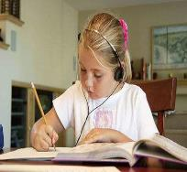

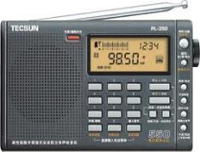
Match
How do you learn English?
listening to English songs
listening to radios
listening to English tapes

Slide 36
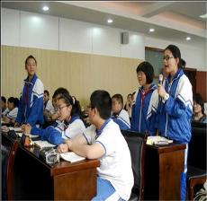
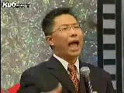
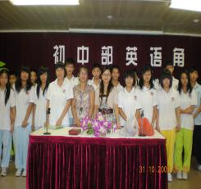
speaking out of class
speaking in class
speaking aloud

Slide 37


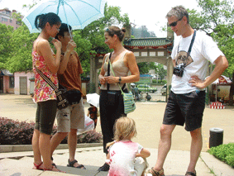
speaking crazily
speaking with
a foreigner
speaking with friends

Slide 38

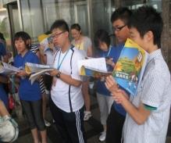

reading English crazily
reading English aloud
reading English textbooks

Slide 39
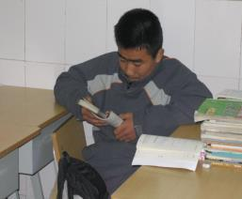
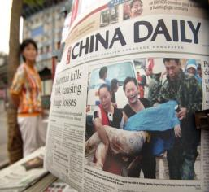

reading English newspapers
reading English notes
reading English magazines

Slide 40
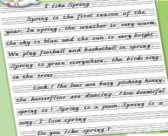

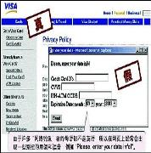
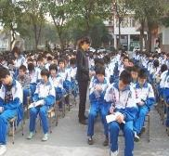
writing compositions
writing/taking English notes
writing/keeping diaries in English
writing e-mails to friends

Slide 41




watching English DVDs
watching English films
watching English TV

Slide 42
asking the teacher for help
asking the classmate for help
memorizing the words

Slide 43
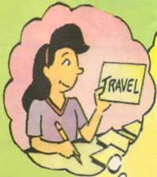
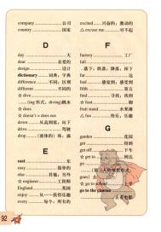
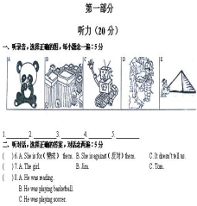
making vocabulary lists
doing a lot of exercises
making flashcards

Slide 44
翻译下列短语。
除非，如果不
处理
3. 担心
4. 生…的气
5. （指时间）过去，消逝
6. 解决一个问题
7. 把…看作…
8. 抱怨
9. 太…以致不能
10. 尽某人最大的努力
11.在…的帮助下
12. 把…变成…
unless
deal with
worry about
be angry with…
go by
solve a problem
regard…as…
complain about
too…to…
try one’s best
with the help of
change…into…

